Slide 1
AI HACKATHON 2019
STAGE II
DeepWind (Deep Learning based Wind Forecasting Model using data from Weather Stations)
Team Registration ID: AIH19T-0152
Participant Details
Chaitali Joshi , VJTI , cpjoshi202@gmail.com
Janavi Khochare , VJTI , janavikhochare99@gmail.com
Jash Rathod , VJTI , jashrathod0@gmail.com

Slide 2
OUTLINE
Part I: Related work
Part II: Data Understanding
Part III: State of the art
Part IV: Experimental evaluation

Slide 3
PART I: RELATED WORKS
One of the algorithms which have been previously deployed and tested for wind speed prediction is the Autoencoders.
Autoencoders generate a compressed low-dimensional structural representation of the time series
Feature representations are learnt using a particular kind of deep learning algorithm called stacked autoencoders
A stacked autoencoder obtains structural representations (i.e. features) at multiple stages by repeated application of autoencoders on the compressed feature space.
Supervised learning algorithms are trained on the compressed feature space.
AE can be considered as an unsupervised variant of a neural network with one hidden layer where the target vector is set to be equal to the input vector.
AE thus tries to learn an identity function. However, by reducing the number of nodes (compared to input) in the hidden layer, interesting structural features can be learned . Normally a backpropagation algorithm is applied to learn the weights in the network.

Slide 4
PART II: DATA UNDERSTANDING
The dataset provided consists of various meteorological as well as geographical conditions of different stations, the total number of features in the original dataset being 18. The target variable is ‘wspd’ i.e wind speed.
The number of rows are different for different datasets.
The data is split into two parts: one for training and another for testing.
The data that is used for testing consists of last 10 values of the total number of rows as in the given problem statement we have to only predict the values for the next 24 hours but we predict more,upto 3 days
So the training set consists of all the rows leaving the last 10 rows used for testing
Firstly, the -9999 values(data missing) are replaced by zero and then these are replaced by the mean of the corresponding columns.
‘lvl12’ column data, consisting of 2 digit numbers, is split into two columns(one of each digit) and onehot-encoding was applied to both columns to convert the data into categorical type.
Similarly, reltime column was split into two columns: hours and minutes.
In some datasets,hour values are not present so we took the reltime values to make predictions

Slide 5
Correlation of each column with ‘wspd’ was found and the relevant features were selected depending on the correlation.
New features were created from pre-existing features of ‘wspd’ and ‘wdir’ corresponding to the data for previous 6, 12, 18,24,30,36,42 and 48 hours to add more features for the model to learn.
Hence, the total number of features used are 'wdir', 'pressure','temp','rh','dpdp' 'wspd', 'gph', 'npv', 'day', 'hour', 'month', 'year', lvl12_1_0', 'lvl12_1_1', 'lvl12_1_2', 'lvl12_1_3', ‘lvl12_2_0', 'lvl12_2_1’
And the additional features used corresponding to the previous readings are 'before_6hr_wspd' , 'before_6hr_wdir', 'before_12hr_wspd' , 'before_12hr_wdir', 'before_18hr_wspd' , 'before_18hr_wdir', 'before_24hr_wspd' , 'before_24hr_wdir', 'before_30hr_wspd' , 'before_30hr_wdir', 'before_36hr_wspd' , 'before_42hr_wspd'.

Slide 6
PART III: STATE OF THE ART
We have used two algorithms: 1) Light Gradient Boosting Machine(LGBM)
2) Deep Belief Network(DBN)
1)Light Gradient Boosting Machine(LGBM):
use previous readings of the data for estimating the future values of the wind.
Light GBM is a fast, distributed, high-performance gradient boosting framework based on decision tree algorithm, used for ranking, classification and many other machine learning tasks.
Since it is based on decision tree algorithms, it splits the tree leaf wise with the best fit whereas other boosting algorithms split the tree depth wise or level wise rather than leaf-wise.
So when growing on the same leaf in Light GBM, the leaf-wise algorithm can reduce more loss than the level-wise algorithm and hence results in much better accuracy which can rarely be achieved by any of the existing boosting algorithms.
lgb_train and lgb_eval contain the training data and testing data respectively.

Slide 7
The hyperparameters which were used and tuned to try and obtain the best model are :
boosting_type: defines the type of algorithm you want to run, default=gdbt
objective: defines if we want to perform regression or classification
metric:specifies loss for model building( in our case, rmse)
num_leaves:number of leaves in full tree
learning_rate:determines the impact of each tree on the final outcome
feature_fraction:selects given fraction of parameters randomly in each iteration for building trees.
max_depth:describes the maximum depth of tree. This parameter is used to handle model overfitting.
num_boost_round: Number of boosting iterations, typically 100+
early_stopping_rounds: parameter can help you speed up your analysis. Model will stop training if one metric of one validation data doesn’t improve in last early_stopping_round rounds. This will reduce excessive iterations.
Predictions are then made on the test data and they are stored in a new column.
Accuracy of the model is found using the formula: (predictions-test/test)*100
The overall accuracy of the model is given by the mean of the accuracy of all the individual test samples.
The metrics that are used to evaluate the model’s performance are rmse(root mean squared error) and accuracy which is described above.

Slide 8
PART IV: EXPERIMENTAL EVALUATION
Result Summaries for GPU
Accuracy of the model: The model achieves an accuracy of about 75-80% for all the datasets. It varies from file to file but remains in the above mentioned range.
Run time on GPU: It varies for different datasets depending on the size of dataset but it is typically between the range of 15-45 min.
Metrics for model evaluation: The metrics that we have used are rmse and accuracy. RMSE is a quadratic scoring rule that also measures the average magnitude of the error. It’s the square root of the average of squared differences between prediction and actual observation.RMSE is more useful when large errors are particularly undesirable.RMSE does not necessarily increase with the variance of the errors. RMSE increases with the variance of the frequency distribution of error magnitudes.
Accuracy = (predictions-test/test)*100
RMSE=√(∑(predictions-test)^2)/no of test samples)

Slide 9
Comparison of Autoencoders and LGBM:
Training speed and efficiency: Light GBM use histogram based algorithm i.e it buckets continuous feature values into discrete bins which fasten the training procedure as compared to autoencoders.
Memory usage: LGBM replaces continuous values to discrete bins which result in lower memory usage than autoencoders.
Accuracy: LGBM produces much more complex trees by following leaf wise split approach rather than a level-wise approach which is the main factor in achieving higher accuracy.
Compatibility with Large Datasets: It is capable of performing equally good with large datasets with a significant reduction in training time as compared to Autoencoders.
Parallel learning supported.

Slide 10
HOW TO REPRODUCE THE RESULT
1. Open FortiClient (Version 6.0)
2. Connect to CDAC VPN, and enter the following credentials:
Login ID : aih2019
Password : fAl@$2019
Click on 'Connect'.
3. For Linux and Mac (PREFERABLE):
Open terminal and enter the following command -
ssh -L 8000:localhost:8000 aih11@login.pune.cdac.in
For Windows (NOT PREFERABLE):
Open MobaXterm. Create an SSH session. Open terminal.
Type: ssh aih11@login.pune.cdac.in -L 8000:localhost:8000
Enter - Username: aih11
Password: aih11

Slide 11
4. Type the string in the given Picture and press enter.
5. Enter Password: aih11
6. Enter the following command: cd AIH19T-0152-Solution
7. Enter the following command: python server.py
8. It will output a message like:
* Serving Flask app "server" (lazy loading)
* Environment: production
WARNING: This is a development server. Do not use it in a production deployment.
Use a production WSGI server instead.
* Debug mode: on
* Running on http://localhost:8000/ (Press CTRL+C to quit)
* Restarting with stat
* Debugger is active!

Slide 12
9. Let the terminal keep running and open a Web Browser (e.g. Google Chrome, Safari, etc)
10. Enter the URL as: http://localhost:8000/
11. We observe the title as 'Deep-Wind (AIH19T-0152)' and place for text input along with a 'Submit' button.
12. Enter a 'station-code' as the text input (e.g. USW00013805) and click on 'Submit' button. (ONLY INPUT THE STATION-CODE AND NOT '.csv'. ALSO, DO NOT KEEP LEADING OR TRAILING BLANK SPACES.)
13. Next, results of the Machine Learning Algorithm are prompted. We can observe 'RMSE', 'ACCURACY', and 'RELATION BETWEEN PREDICTED AND OBSERVED WIND SPEED'.
14. To try another station-code, click on 'Back' button of the browser and follow steps 12 and 13.
15. Once you are done, close the browser. Switch back to the running terminal. To stop the running server, press 'Control-C'.

Slide 13
POINTS TO NOTE:
1. Depending on the size of the file of the station-code, it might take from 10 seconds to 45 minutes to run the code.
2. If the entered station-code does not exist, 'Invalid' will be prompted.
VIDEO:
A video has been added in the presentation in one of the later slides and also has been uploaded in the solution folder on the cluster.
Link: https://drive.google.com/file/d/1FoooDdKS5WU8TV3KEAHa7BZdKIaP2ykF/view?usp=sharing

Slide 14
SUMMARY
Data Cleaning:
Even after cleaning the dataset we didn’t get the results we wanted to achieve because the dataset was not in a pattern.
The dataset provided was very skewed, we wanted a time series analysis for forecasting so we wanted the data to be continuous, the data provided consisted of many different values of wind speed for the same hour , and the data provided didn’t contain the minutes value
It didn’t make sense to have 7 to 12 values of wind speed for the same hour at the same location and same latitude and longitude
So we decided to combine the data of of the wind speed into a single value for the same hout , we achieved this by taking the mean of the wind speed for the same hour of the same day
After doing this we found a pattern in the hour value, we found that the wind speed values were recorded after every 6 hour interval, with its value being 0 hrs, 6 hrs, 12 hrs and 18 hrs in most of the dataset for a single day

Slide 15
The features provided we not much correlated to the target variable wind speed
So we decided to add features inorder to predict the future values, we added the features like before_6hrs_windspeed, before_6hrs_winddirection , before_12hrs_windspeed, before_12hrs_winddirection ,before_18hrs_windspeed, before_18hrs_winddirection ,before_24hrs_windspeed, before_24hrs_winddirection,
before_30hrs_windspeed, before_30hrs_winddirection.
These extra features added great value of correlation to the target variable wind speed(wspd).
In some datasets the the value of hour was not provided so we took the reltime hour and value.
DATA SPLITTING :
Now as the dataset was cleaned and the data is cleaned pretty well and pattern is observed in the data so we move ahead to the data splitting
We have splitted the data into 2 sets Train and Test set
The Test set consists of last 10 values of the total number of rows as given in the problem statement we have to only predict the values for the next 24 hours but we predict more,upto 3 days

Slide 16
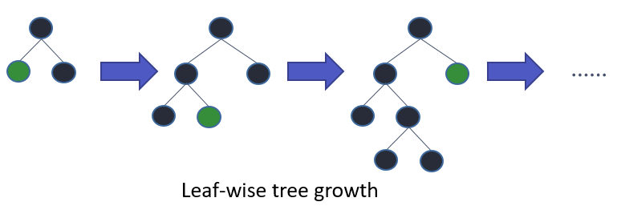
ALGORITHM:
After this the an important part of choosing the right algorithm comes into the picture.
As we have done a lot of preprocessing in the data so that the data appears in a pattern we can apply a good regression algorithm on this dataset.
We applied Light Gradient Boosting to this training data.
Light GBM is a fast, distributed, high-performance gradient boosting framework based on decision tree algorithm, used for ranking, classification and many other machine learning tasks.
Since it is based on decision tree algorithms, it splits the tree leaf wise with the best fit whereas other boosting algorithms split the tree depth wise or level wise rather than leaf-wise. So when growing on the same leaf in Light GBM, the leaf-wise algorithm can reduce more loss than the level-wise algorithm and hence results in much better accuracy which can rarely be achieved by any of the existing boosting algorithms. Also, it is surprisingly very fast, hence the word ‘Light’.
A diagrammatic representation by the makers of the Light GBM to explain the difference clearly.

Slide 17
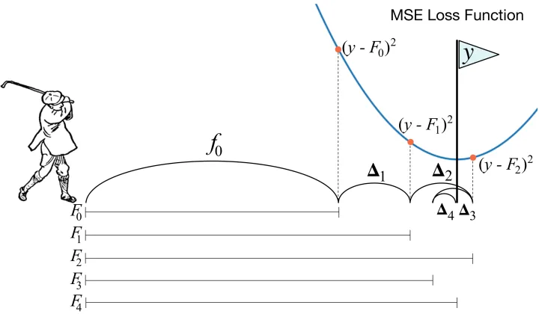
Why did we choose Light Gradient Boosting model over Deep Learning Autoencoder model?
We tried to do regression with Autoencoder neural networks, but the lightGBM result is always better than Autoencoder result. For simplicity, we use only one feature and we couldn’t reach lightGBM level of accuracy when we tried Autoencoder model. We tried using RNN cells, LSTM, batch normalization, different data transformation - result is always the same, lightGBM result much more better.
The reason for this was, GBM pushes decision trees to close accuracy level of neural networks. Its approach is that a single decision tree is not strong enough. Applying a decision tree algorithm based on the error of the previous round is getting closer or going beyond to neural networks accuracy. Besides, it is still explainable.

Slide 18
It takes a long time to run a DL algorithm on that dataset, and anyone would only normally try deep learning on specialist problems where there's some hierarchical structure in the data, such as images or text.
It's overkill for a lot of simpler learning problems, and takes a lot of time and expertise to learn and also DL algorithms are very slow to train.
Additionally, we have preprocessed our dataset so that doesn't mean we need to use the entire dataset to get good results.
Depending on the data, we may get good results with a sample of a few 100,000 rows or a few million, and as our data is now in pattern we decided to move towards Ligth Gradient Boosting over Deep Learning Autoencoder model.
Tuning of parameters :
Now as we have selected the best model for our dataset, tuning the model is important otherwise it won’t work at its best.
So we have tuned various parameters like num_leaves, max_depth, learning_rate , feature_fraction of LGBM and selected the best.
Our dataset values are:
params = {'task':'train', 'boosting_type':'gbdt', 'objective':'regression','metric': {'rmse'}, 'num_leaves': 10, 'learning_rate': 0.08 , 'feature_fraction': 0.7, 'max_depth': 10, 'verbose': 100, 'num_boost_round':2500, 'early_stopping_rounds':1000, 'nthread':-1}

Slide 19
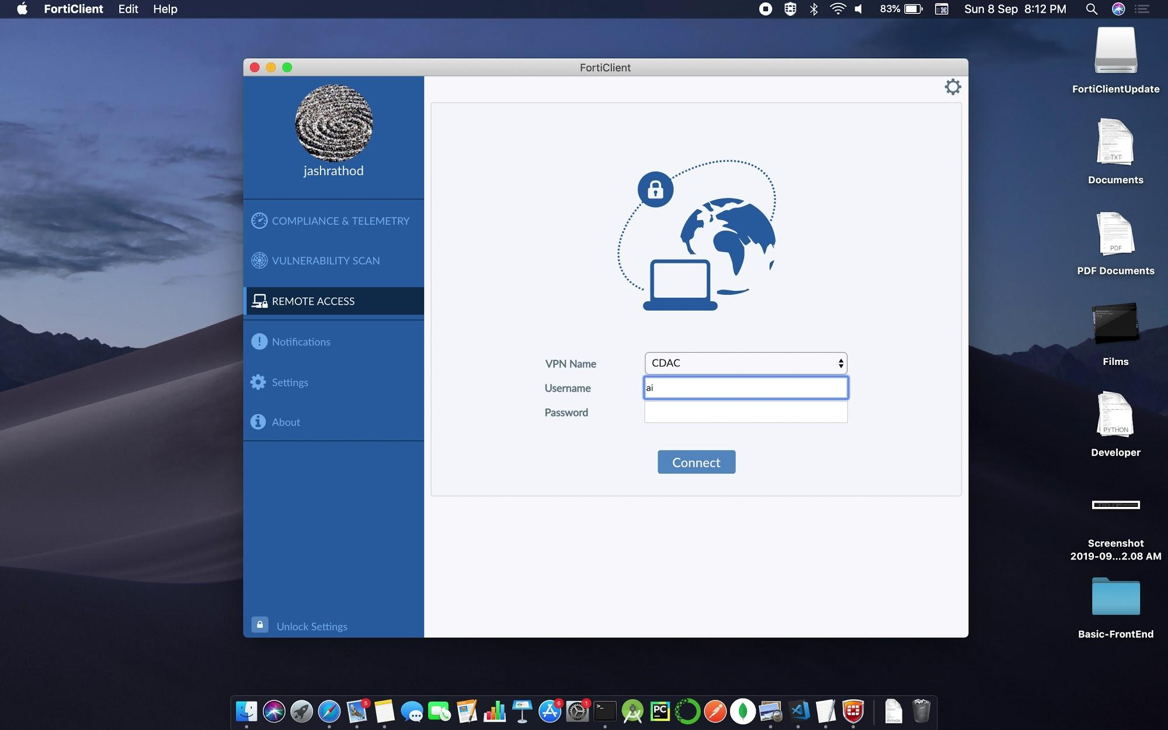
System Overview / Workflow Overview:

Slide 20
Differ from existing technique/innovations:
Our main problem was to clean the data well and get it into a certain pattern as the dataset was a skewed one with certain vague and missing values so arranging the data well and getting it into a pattern in a way explained in the summary earlier can be considered as a innovative way as we found out a way to use this data rather than deleting some rows
As this dataset doesn’t contains a good features and getting good features are very important in any dataset to predict the future values, so we added the new features by taking the previous wind speed and wind direction values and this can also be considered innovative as we are making good use of the dataset given and this helps in increasing the accuracy of the model by a huge value.
Further rather than using Autoencoder technique for predicting the forecast we moved towards Light Gradient Boosting which is pretty efficient and best method for our dataset (in terms of accuracy)

Slide 21
GPU utilization for training and inferencing
For this project statement, the usage of GPU was done effectively and efficiently.
Training was done by loading the modules cuda/9.0 and cuDNN in a python script file and using the SLURM Scheduler and SLURM Commands.
Using ‘sbatch’ command, the job was submitted from login node.
Upon completion of the job, the output was checked and the parameters/hyperparameters were tuned to obtain promising results.
Once good Validation Accuracy and Root Mean Square Error (RMSE) were achieved, the model was saved/pickled for further use.
For inferencing, this pickled model was used to avoid the usage of overhead computational resources.
It was made sure that the GPU was utilized in the most efficient manner.

Slide 22
SUMMARY: FUTURE DIRECTIONS
We will future try to increase the accuracy of the model by studying and understanding more about the data and improving our Light Gradient Boosting Model.
We will also try Ensemble models like stacking.
What exactly is Ensemble Learning?
Ensemble learning helps improve machine learning results by combining several models. This approach allows the production of better predictive performance compared to a single model.
That is why ensemble methods placed first in many prestigious machine learning competitions, such as the Netflix Competition, KDD 2009, and Kaggle.Ensemble learning is a machine learning paradigm where multiple models (often called “weak learners”) are trained to solve the same problem and combined to get better results.
The main hypothesis is that when weak models are correctly combined we can obtain more accurate and/or robust models.

Slide 23
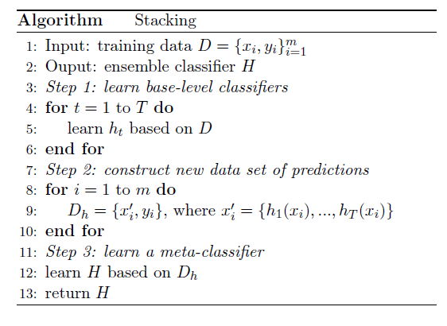
What is Stacking?
Stacking is an ensemble learning technique that combines multiple classification or regression models via a meta-classifier or a meta-regressor. The base level models are trained based on a complete training set, then the meta-model is trained on the outputs of the base level model as features.
The base level often consists of different learning algorithms and therefore stacking ensembles are often heterogeneous. The algorithm summarizes stacking.

Slide 24
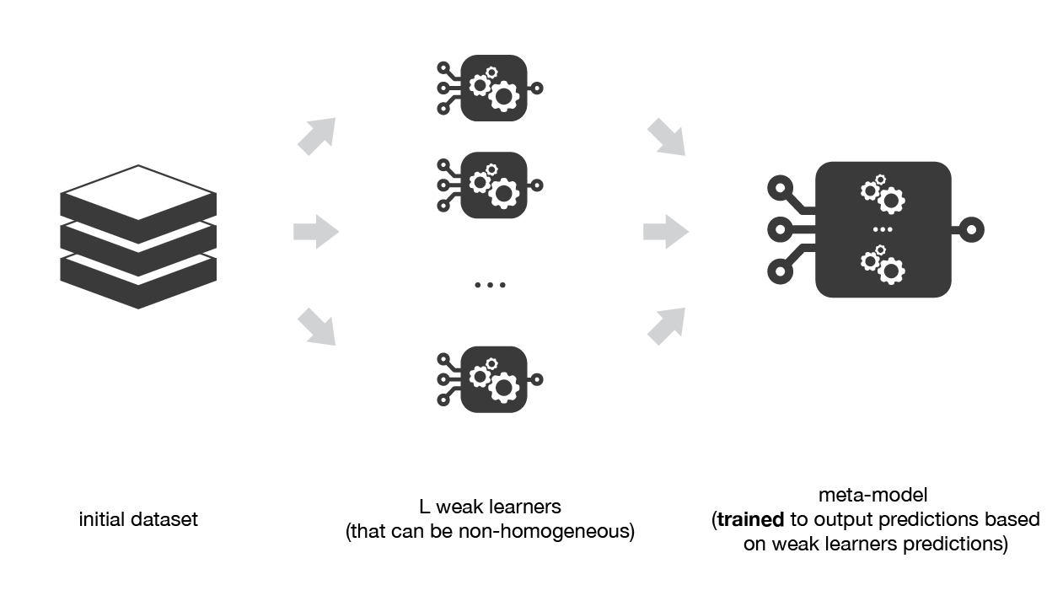
A simplified version is as follows:
Split training set into several folds.
Train each model in the different folds, and predict on the splitted training data
Setup a simple machine learning algorithm, such as linear regression
Use the trained weights from each model as a feature for the regression
Use the original train data set target as the target for the regression

Slide 25
THANK YOU

